Slide 1
WPF Layout
Notes:
WPF Layout

Slide 2
WPF Layout
Common Layout Properties
Panels
ScrollViewer
Navigation

Slide 3
Declarative Layout
Declarative API
  We tell WPF what the requirements are
    In XAML (Most of the time)
    Customize the behaviour in code (unusual)
  WPF will meet those requirements when generating.
Goals of the declarative API:
  Resizable
    Adapt to different screensizes and change in orientation
  Dynamic
    Data
      Amount of space needed to present the data
    Localization
      Change in the language
Notes:
Declarative Layout
How does WPF's layout system look to us as developers?
WPF aims to present a declarative API. The goal is that we tell WPF what our layout requirements are and that it will do all the work of meeting those requirements during the measure and arrange phases.
For most common layout scenarios you won't need to write procedural code to participate in this process. You will be able to define the layout entirely in XML.
Well if you have unusual layout requirements you can always customize the behavior in code.
The tools WPF provides us for declarative layout aim to achieve a couple of goals.:
They aim to make it easy to produce resizable user interfaces that can adapt to the amount of space the application finds itself with.
This makes it easy to handle varying screen sizes and orientations.
WPF elements are also designed to support dynamic changes to layout.
For example, if you are using data binding to present information, the layout system can adapt to fit around the amount of space needed to present each data or item.
This adaptability is also useful for localization scenarios. A layout that can adapt to changes may be able to cope with changes with the language without needing to be reperformed.

Slide 4
Common Layout Properties
Set of layout properties for all the elements in the UI Tree
Common Layout Properties
Margin
Padding
HorizontalAlignment
VerticalAlignment
Min/MaxWidth
Min/MaxHeight
Width, Height
Notes:
Common layout properties
In the slide you can look at the common layout properties offered by WPF.
There is a set of properties dedicated to layout you'll find across all the elements in the user interface tree.
These provide the consistence and the mechanisms for managing the layout.

Slide 5


Pluralsight video: Declarative Layout

Slide 6
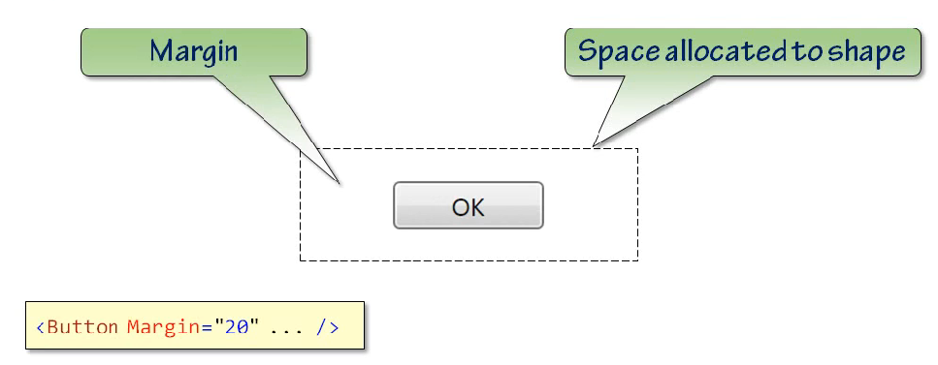
Margin
Space around the edges of an element
Unit: Device independent pixel = 1/96 of an inch = default size of pixel in Windows system
Notes:
Margin
The margin property lets you determine how much space there is around the edges of an element.
For example, suppose WPF is determined that a particular UI element is going to be allocated a certain amount of space on the screen.
You might not want the element to fill that space completely but ty up against its neighbors. You might want some breathing space around it. And the margin property manages this. It lets you say how much daylight you want around the element.
In XAML you can specify just a single number as the margin, indicating a uniform amount of space around the control.
If you are wondering what the units are they are so called device independent pixels. That's an oxymoron because if anything is device-dependent it's a pixel. So what this really means is that the unit is nominally 1/96 of an inch.
So, for example if you specify a margin of 96 pixels your element shouldin theory have a 1 inch space all the way around it. Whether that's exactly true in practice depends on whether Windows knows the resolution of the output device. With printers Windows generally does know the printer's resolution and so a distanceof 96 units will usually be exactly one inch on paper whether that correspondsto 300 or 600 or whatever pixels. Unfortunately things are harder to predict on screen because very few people configure their machines in such a way that Windows knows how big the pixels are on their monitor. And there is no standard way for Windows to also discover this information from the hardware. So, in practice most Windows PCs end up with a default configuration in it. And if Windows doesn't know how big your pixels are on screen it will guess that they are 1/96 of an inch across. This isn't specific to WPF by the way. That's always been the default guess in Windows. Although if you configure Windows to use large fonts it presumes that you probably have smaller pixels than average and uses a different guess. So it revises the guess to 120th of an inch. So the vast majority of the time a unit of 1 WPF device-independent pixel happens to correspond exactly to 1 pixel on screen. And this is deliberate. It's no coincidence that WPF has chosen the measurement system that happens to correspondto the default guess pixel size on a Windows system. But you should not depend on this. On systems configured in large fonts mode for example, Windows guess is the pixels are smaller, 120th of an inch. Which means that the WPF unit will now be slightly larger than a physical picture. For example if you choose a margin of 96 device independent pixels on a machine with large fonts that will actually produce 120 pixel margin. And this sort of makes sense because the size you asked for 96 theoretically corresponds to one physical inch. And in the default Windows configuration, the large fonts Windows guesses that the screen packs about 120 pixels into 1 inch. But since the vast majority of PC's are completely misconfigured with respect to screen resolution the behavior ends up being a bit confusing in practice. If higher resolution screens such as the 200 dpi screens that you can get they have become popular and take off. Then it will become more important to ensure that Windows has an accurate idea of how big your screen's pixels are. So, maybe one day WPF's device-independent pixels will really correspond reliably to a size of 1/96 of an inch. But today just regard them as something roughly pixel size.

Slide 7



Margin
20 pixels for all margins
Horizontal margin: 20 pixels
Verical margin: 30 pixels
Left, top, right, bottom
margin (not the same
order as in CSS)
Notes:
Margin
You can specify the margin as a single number, 20/96 of an inch in this case, here.
Or you can provide 2 numbers. This example sets the horizontal margin to be 20 pixels and the vertical margin to be 30.
Or you can specify the left, top, right and bottom independently. And CSS developers, please take note, this is. not the same order as you get in CSS. WPF specifies the left margin first.
Also (unlike with CSS) if two elements in a stack that are next to each other both have a margin of 10, the total amount of space between them will be 20 so it doesn't sort of say, or a margin of 10 on either side will coalesce that into a space of 10. It actually adds them together.
This is just for user interface elements, by the way. The TextFlow layout engine in WPF has a different set of rules because the requirements for text layout are quite different but we're not looking at that layout engine in this section.
Right now we're focusing on user interface layouts so its margin works in the way I've just described.

Slide 8
Pluralsight video: Margin

Slide 9
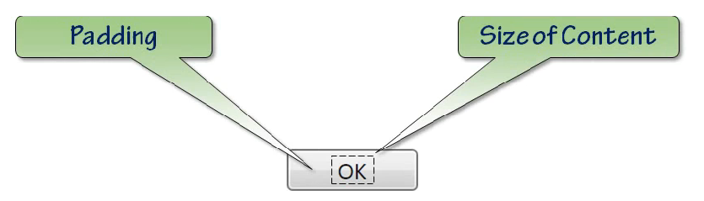



Padding
Space between boundary and the content
Notes:
Padding
A close relative of margin is padding.Whereas margin represents the space around the outside of an element, padding represents the space between the border of the element and the content it contains.
Padding is not universally available because it only makes sense with elements that can contain other elements and not everything offers a content model.
For example rectangles don't have children. But for elements with content, these will have a padding property and it lets you say how much space the content should have between it and the containing chrome.
And as with margin, in XAML we can specify a uniform padding with just a single number or separate horizontal and vertical padding or distinct values to the left, top, right, and bottom padding.

Slide 10
Pluralsight video: Padding

Slide 11
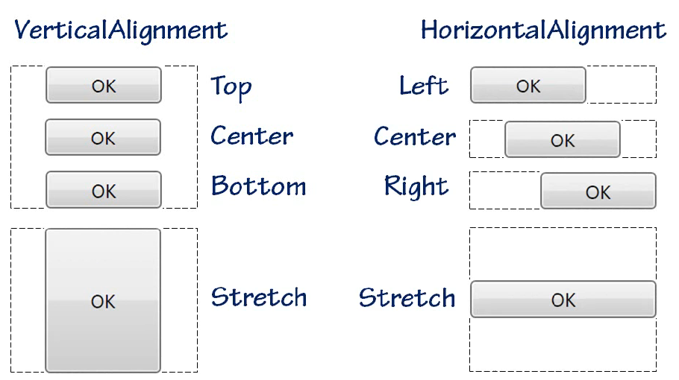
Alignment
When more space than an elements requires → alignment decides how elements use this space
Default
Notes:
Alignment
Often, WPF will find that it has more space than an element requires and there are some common alignment properties that determine how the elements use this space.
There’s VerticalAlignment which indicates the vertical positioning within the available space and this can be top or center or bottom or the default value of stretch.
HorizontalAlignment works in a similar fashion. Here we have left and again center, right and again the default is stretch.
The choice you make here is one of the things that determines whether the child element gets constrained or unconstrained layout. Let's look at an example.
Here's a button. Notice that I've not specified any alignment settings nor have I provided an explicit width or height and the button is filling the entire available space and that's the default in this scenario.
This is the most basic example of a button and it fills all the space, thanks to the default, vertical and horizontal alignments of stretch. This is an example of unconstrained layout.
The height available to the button is constrained by the end-user. I get to decide how tall the button is by moving this vertical splitter and the button's width is constrained by the size of the window itself. So when this button's measure method gets called, it's passed in the width and the height of the available space here and then during the arrange phase, it's given the same space again because that's what XAML Pad does. It gives the content the entire space regardless of what the content may be asking for.Now what if I change these buttons horizontal alignments property? Set horizontal alignment to be left. Now we can see that horizontally the thing is sizing to content. So I'm now getting constrained handling of the button itself and in fact, any horizontal alignment other than stretch will flip into this unconstrained mode. So if I center or right align, in all three cases it's measuring the required width of the button rather than giving it all of the space. So because of the horizontal alignment, when WPF calls the button's measure method it's now passing in positive infinity as the available width and this, remember, is a signal to the button that it should work at how big it needs to be. So the button, in turn, passes that positive infinity width on to its content and recursif called to measure and then uses the result that comes back out to work at how wide the buttons should be overall and the same thing will happen if I set the vertical alignment to be anything other than the default of stretch. So if I center this, then again it's going to size to content. So although I'm still able to change the constraints of the containing area,the button is ignoring this 'cause it's now sizing to content regardless of how much space is available.Note that these alignment properties only mean anything if more space is available than is required. In situations where an element has been given no more space than it needs, there's no space within which to align in which case these properties do nothing.

Slide 12
Demo WpfAlignment
<Button Content=“OK” /> → stretched
➔ Resizing the window → has effect on width/height of the button
<Button HorizontalAlignment=“Left” />
→ width of the button = the required width (width of the content)
The same happens with VerticalAlignment
➔ Resizing the windows → has no effect on width/height of the button

Slide 13
Pluralsight video: Alignment

Slide 14
Content Alignment
Alignment
  → How element uses extra space provided by its container
ContentAlignment
→ How the content inside an element is positioned
Alignment ~ ContentAlignment
Margin ~ Padding
Notes:
Content Alignment
Horizontal alignment and vertical alignment determine how an element uses extra space provided by its container.
There are corresponding content alignment properties that determine how the content inside the element is positioned.
For example, you can use this position to caption within a button. The relationship between the content alignment properties and the alignment properties is very similar to the relationship between padding and margin.
So you'll only find these properties on elements that are able to contain content.

Slide 15
Pluralsight video: Content Alignment

Slide 16
Explicit Width and Height
Width and Height properties
→ zelf breedte en hoogte instellen ipv beschibare / nodige ruimte
Notes:
Explicit Width and Height
Sometimes the size that either constrained or unconstrained layout will offer to an element will not be quite right. You might just want to fix an element's size.
For example, it's quite common to fix buttons width and height. Buttons can look a bit stupid if you let them fill all the available space and they can look a bit small if you let them size to content.
And in any case, there's a standard size for a button in Windows. So when you drag a button from the toolbox into the user interface from either Blendor Visual Studio, they choose a fixed size for you by setting the width and height explicitly. While this is appropriate for some kinds of elements, fixed sizes aren't flexible so you shouldn't make them your default choice. It's worth considering variations on this theme. There's MinWidth and MinHeight and also MaxWidth and MaxHeight. These let you put lower and upper bounds on size while still aligning the layout systems and flexibility.

Slide 17
Pluralsight video: Width and Height

Slide 18
Layout controls
Grid
StackPanel
DockPanel
WrapPanel
Canvas

Slide 19
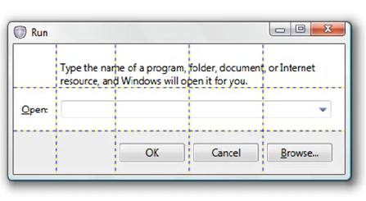
Grid
Default layout element when you create a new window
Column and Row sizing
  Automatic
  Fixed
  Proportional
Elements can span cells
Fine control with Margin
Demo: WPFGrid
Notes:
Grid
So we've looked at the common layout properties but these are only half the story. The layout system provides several different styles of layout and each of these is made available as a panel element.
The most flexible one is grid. Grid derives from Panel and provides a row and a column oriented approach to layout.
A grid supports a mixture of constrained and unconstrained layouts. You can choose the latter by setting a row or a column to have an automatic size and for constrained layouts, you can choose either a fixed size or proportionally sized row or column in which the grid shares out the total available space proportionally.
Let's look at an example. I've created a grid here with three rows and three columns. I put each button into a grid cell so that you can see the grid pattern. Notice the use of attached properties to specify which row and which column the elements belong to.
Now also see that I've defined the number of rows and columns using this RowDefinitions and this ColumnDefinitions collection property. As you can see up here, the default behavior is that the rows and columns are equally spaced.
Now I can resize the window and as you can see, the rows are all resizing at the same rate and the same will happen if I resize this horizontally.
But I can cause a row to size to content by changing its definition.
If I set this row's height to be auto,that puts us into unconstrained layout and the row sizes to content.
More precisely, the grid is calling measure on each child on the row in turn with an unconstrained height and then for the arranged phase, it chooses the height of the tallest child.
So if I make one of these children taller, for example if I change the font size, that has an effect on the entire row.
If I make it a bit bigger, it'll be a bit more obvious. So this button has decided it needs to be that tall and then that's the tallest ones so it wins.
So the other two buttons have come along for the ride if you like. But I can now use the alignment properties to decided how these two buttons here are going to sit in their containing cells.
So if this first one, if I set its horizontal alignment to be left, and its vertical alignment to be top, you can see it's now using just as much space as it requires rather than filling the entire cell.
And if I do the similar thing to the third one, let's align this one to the bottom within its containing cell and align this one to be right.
I can also move elements around within their grid cell using the margin property.
For example if go back to this first one and just set the left and the top margin, I can move the elements around.
These have now become in effect the X and the Y position within the cell.
I can also apply margin to ones that are not using this size to content approach. So if I put a margin on the second row, then you can see it just pushes the thing in from the edges.
So the margin can either be used in the obvious sense of just saying how much space there is around or I can use it in conjunction with the alignment tools as a mechanism for deciding where within the cell this element's going to appear.
Now notice the two rows that I didn't change the height of, they're still sharing out the available space.
So what's happened here is that the first row has decided how tall it needs to be,then whatever space is left gets shared out between these two rows. And right now, they're using the same amount of space.
But I can change this using what's called "star sizing“ and that name comes from the XAML syntax. If I make this 2 star, that's where the name comes from.
And now this row here that I just changed is twice the height of the other row. If I make it 3 stars, 3 times the height. If I make 4 stars, 4 times the height.
So the relative proportions of the numbers here determine how much of the share they get of the space that's available. And by the way, the default height and width of all rows is actually 1 star.
If I set that explicitly, the behavior doesn't change. Now, the absolute values of these heights and rows of using star sizing doesn't actually matter. It's not relevant. It's the relative values that are important.
So it's how big is this number relative to this one, is all that's significant. So if I stick a zero in the end of both of these, it doesn't change the behavior because 20 is twice as big as 10, just the same way that 2 is twice as big as 1.
So it's the relative values that matter not the absolute values. By the way, these things are floating point numbers so you're not stuck with whole numbers. You can use fractions as well.
Fixed width and fixed height work exactly as you'd expect them to. I just set this to be a number without a star on the end. That's now 30 pixels tall.
I don't have quite enough space without including the margin there, so maybe I should make a slightly bigger number there. Let's have 60.
And now we got 1 row size into content, one row with a fixed sized and one row that is using star sizing. That just gets all the remaining available space.
Now, one more trick the grid can play is you can have more than one element in a particular grid cell.
So I could make something share this cell in the top right here with the button that's already in that.
Let me add an ellipse and I'll set its grid row to be zero and its grid column to be 2. And also, that's fill to be blue.
And by default, it will actually stretch to fill the space available. I don't actually need to specify width and the height in this particular case because the grid does that for me.
I could specify fixed width and height if I prefer though. And in either case, you can see it sharing this grid cell with this button.
This is why we have to be explicit about which row and which column things are in because you might have thought it would be simpler if they just base the cell membership on the order in which the elements appear like the HTML table does. But they don't do that because multiple elements may be in a single cell. Also, an element may span multiple cells.
I can if I want have an element that fills more than one of the cells. So I take the automatic width and height back off here and move this across one.
I can then set the Grid.ColumnSpan to be 2. It will now span 2 columns. And as you can probably guess, there is also a Grid.RowSpan. It does not say how many rows it covers.
Grid is very flexible.
It supports a combination of constrained and unconstrained layout.
It supports fixed sizing and variable sizing.
And as you saw, we can use the margin and alignment properties to set the positionof elements within a cell giving us fairly fine control over the layout.
So the grid is the default layout element of the root of a user interface when you create a new window in either Visual Studio or Blend.
It might not be obvious that it's a grid from interacting with the design surface because both of them let you drag elements around freely in what feels more like a canvass-style of layout.
But the design tools, achieve this by modifying the row, column, span, margin and alignment properties for you.

Slide 20
Pluralsight video: Grid

Slide 21
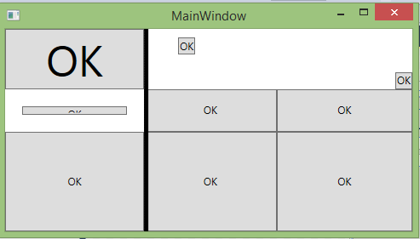
GridSplitter
Add to a cell / cells
Set Direction
Resizes columns/rows when dragged
<GridSplitter Grid.Column="1"
Grid.RowSpan="3“
HorizontalAlignment="Left"
Background="Black"
Width="5"/>
Notes:
GridSplitter
One common requirement for a grid like layout is to let the user resize rows and columns.
You can do this by adding GridSplitter control.
You just position this within the grid and it will modify the width of its containing column or the height of its containing row and on the nearest neighbor.
So what you need to do is drop a GridSplitter into a grid in Blend or in Visual Studio. Set its orientation to horizontal or vertical as appreciate, and it just works as you'd expect. And you've already seen this control in action.
A GridSplitter is what lets us resize the preview area in XAML Pad.

Slide 22
Pluralsight video: GridSplitter

Slide 23

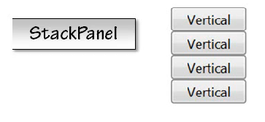
StackPanel
Stacks child elements below or beside each other
Property: Orientation (Vertical or Horizontal)
Internal layout panel of ComboBox, ListBox, Menu, …

Slide 24
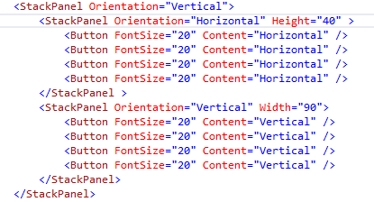
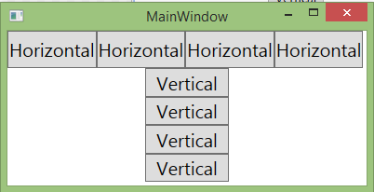
StackPanel

Slide 25
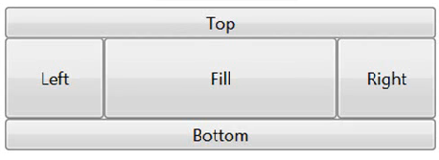
DockPanel
Arrange your child elements either horizontally or vertically relative to each other
Less effort to use than a Grid

Slide 26
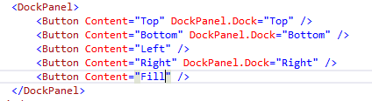
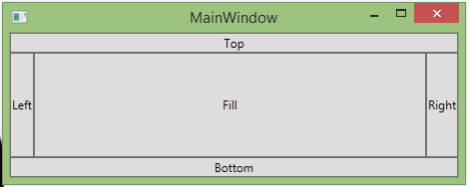
DockPanel

Slide 27

WrapPanel
Wraps the elements to new lines (horizontal orientation) / new columns (vertical orientation) if no space is left in the width / height of the container

Slide 28

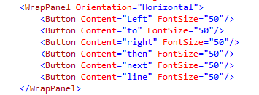
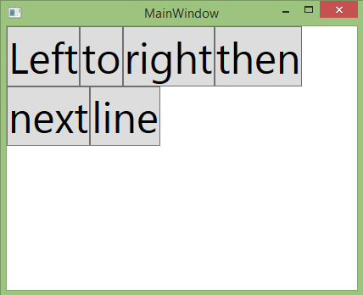
WrapPanel
Notes:
DockPanel, StackPanel, WrapPanel
Although the grid is powerful, it's also occasionally hard work.
So WPF provides some simpler panels.
StackPanel arranges items in vertical or horizontal stacks.
DockPanel lets you position elements at the top, bottom, left or right of a space or have them fill the remaining space.
You can construct equivalent layouts with a grid but these simpler panels are sometimes less effort to use.
So they provided mainly as a convenience.
There's also WrapPanel. This performs a word wrap like layout. It arranges elements one after another much like a StackPanel.
When it runs out of space, it starts a new line. Or in the case of vertical WrapPanel, it starts a new column.
WrapPanel layouts is not something you can easily duplicate with a grid so this panel type is more than just a convenient shortcut.

Slide 29
Pluralsight video: Dock-, Stack- and WrapPanel

Slide 30
Canvas
Simpliest panel
No layout → puts elements where you tell it to
Allows the elements to size to content
Position → Canvas.Left, Canvas.Right, Canvas.Top, Canvas.Bottom properties
Inflexible style of layout → designed for drawings (not for ordinary UI layout)
Notes:
Canvas
Canvas is the simplest panel. It performs no layout at all. It just puts elements where you tell it to and allows them to size the content.
In other words, it always performs unconstrained layout of its children.
The position of children is controlled with the attached Canvas.Left and Canvas.Top properties.
This is an inflexible style of layout. It will not adopt the changes to the available space. It's designed for drawings where you positively don't want things to move around as the container resizes hence the name "canvas”.
It's not recommended for ordinary user interface layout.

Slide 31
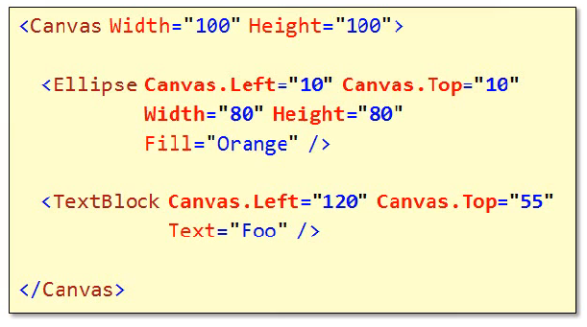
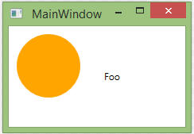
Canvas

Slide 32
Pluralsight video: Canvas

Slide 33
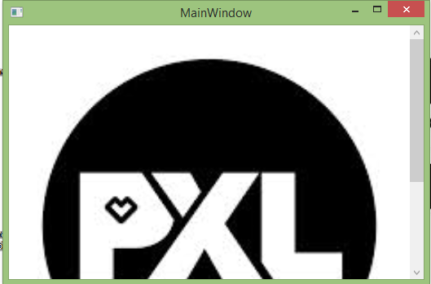
ScrollViewer
Wraps any element
<ScrollViewer>
<Image…. />
</ScrollViewer>
Offers usefull layout
features
Notes:
ScrollViewer
Another layout related component is the ScrollViewer. This is not a panel. It's actually a content control.
It offers a useful layout feature that it lets you contain content that just won't fit on the screen.
The ScrollViewer performs unconstrained layout in its content and tells the content that it has exactly as much space as it ask for.
Unless it asks for less space than is available, in which case, the ScrollViewer arranges the content to fill the space completely.
Obviously, since the ScrollViewer always gives its child at least as much space as is required,the size of the child is unbounded. But this is virtual space, it's not really that big on the screen.
The ScrollViewer applies a clip and a translate transform to show a view on to that virtual space, and off the scroll bars, to let the user pan around the content.
The child doesn't need to know that it's being scrolled. If you put an image element showing a bitmap that has a 4,000 by 3,000 device independent pixel image that's about 3.5 by 2.5 feet. Keep that inside a ScrollViewer, the image element will think it really has got that much space and it can remain happily oblivious to the tricks the ScrollViewer plays with the layout. So you don't need to write any special code to handle the scroller. You can just program as though the virtual space offered inside the ScrollViewer is real.
Having said that, it is sometimes used for the right code that participates in the scrolling process. You might not want to fully populate the virtual space up front as it might be more efficientto load that content on demand as the user scrolls around. If you want to do that, you can. There's an interface called IScrollInfo and if the child element inside the ScrollViewer implements that interface, the ScrollViewer will stop pretending that the child's virtual space is real. And it will let the child get directly involved in creating the illusion of a large scrollable region.

Slide 34
Pluralsight video: ScrollViewer

Slide 35
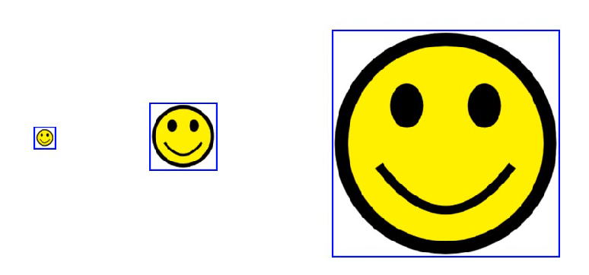
ViewBox
ScrollViewer puts scrollbars when content does not fit ←→ ViewBox scales the content (makes it larger/smaller as necessary to fit available space
Notes:
Viewbox
Like ScrollViewer, Viewbox offers a solution to fitting content to some fixed size into a constrained space.
But while ScrollViewer adds scroll bars when the content doesn't fit, Viewbox scales the content making it larger or smaller as necessary to fit the available space.
You could use this to display an image. Taking advantage of extra space where available to get a better representation of detail, but still ensuring that the whole image fits when there's less space.
As it happens, for bit map images, you don't need a Viewbox because the image element can-- already do it’s resizing for you.
But the Viewbox can do it to any kind of content. Bitmaps, vectographics or mixture of the two or even user interface elements like buttons.
Here's a canvas containing some graphics wrapped in a Viewbox. Notes that I've set a fixed size on the canvas itself. That's important. Viewbox needs to know exactly how big the contents is and it is a constrained layout. The whole idea behind Viewbox is that it resizes only to fit the space available and it can only work out the right scale factor to do that if it knows how big both the thing to be resized as and how large the available space is.
In layouts, where either of those things is negotiable, then there's not really any place for the Viewbox. Now, you can see that this picture resizes as I change the available space. And you can also see that it's scaling uniformly by default.
The image is filling the vertical space but it's leaving the horizontal space unused. Or, if I make the window sufficiently narrow, it will do the converse. It will easily available horizontal space and will leave some ways of vertical space.
Basically, it's making the image as big as it can be to fill the space without cropping it at all. It's a default behavior but I can change this with the Viewbox's Stretch property.
If I set stretch to be equal to Fill and it no longer uses a uniform stretch, it stretches by different amounts in the X and the Y direction to make the image fill the space available or there's uniform to fill.
This says I want the image to be big enough to fill the entire space and I want to have uniform stretching and if that means cropping the image in one direction then so be it. If I make the thing narrow enough you'll see it will start to crop in the other direction. So if the shape of the space is just right it will fill it completely and if it's too wide or too narrow then it will end up cropping in one direction or the other.
By the way the initial behavior we saw the default corresponds to a value of unit 4. That's the default value for stretch.

Slide 36
Pluralsight video: ViewBox

Slide 37
Windows
Window
  Content control → contains a single piece of content
Popup
  Content control
  Transient window (also used by combobox, menu): goes away when you click outside the window
Notes:
Windows
An important part of the layout of any user interface is the window that contains all the content. Most WPF windows use the simple Window class.
This is a content control so it contains a single piece of content. Window offers various properties to determine which window board you want or you can turn off the chrome entirely.
There's also an option to make the window transparent using windows layered windowing service. This lets you determine the windows apparent shape entirely with the WPF content.
There's also the Popup class, WPF uses this for menus and for the drop down for the combobox.
If you want similar popup’s (content that appears transiently and which goes away when the user clicks outside the window) you can use Popup yourself.
It's a content control too, so it's similar in use to the window class.

Slide 38
Pluralsight video: Windows

Slide 39
Navigation
NavigationWindow (3rd Window class)
  Contains a Page
  Can navigate between pages (Back and Forward Buttons)
  DEMO: WPFNavigation
Frame: nested navigation area
Notes:
Navigation
There's a third window class called NavigationWindow. This is slightly different from the normal window and it is designed this whole different UI tree over its lifetime.
The content for the NavigationWindow is defined as a separate item: a page. You can switch between pages into the window over its lifetime.
This is a very similar model to a web browser which also navigates from one page to another. And the NavigationWindow offers a similar user interface.
It provides back and forward buttons to let the user navigate back and forth through pages.
Here's a project in which we use a NavigationWindow. As you can see I've got a couple of pages in this project.
You create pages as much the same way as a window. They're just XAML with code behind.
To move one page to another you have to perform a navigation operation.
We can do that here with a hyperlink in page one. Hyperlink is the WPF equivalent to the A-tag in HTML and the NavigateUri is like the href attribute. It says where to go when the link is clicked.
So this is saying that we should go Page 2 when the link is clicked.
Now there's no window in this project, I've removed the window1.xaml that gets put there by default. So how does WPF know to load this up into a window for me?
Well if you look in the App.xaml we see this StartupUri property, this is present in all WPF applications and it says what the first thing to be shown in the application should be.
By default this says window1.xaml but I've changed this to point to Page1.xaml.
I'm going to run the application. WPF is going to see that and see that's not a window that's a page, I better create a NavigationWindow to host that page.
So let’s see what happens when I run this. So you can see it's loaded up the page and you can also see the back button and the forward button at the top here.
Sort of browser like thing that created that right now because there's no browser history in here but if I click on the link it loads up the second page and you can see the back button is lit up and I can go back and forward between the two pages and you can see it's given me this history list just like you get in a web browser.
Pages can also be hosted inside of some other user interface just as HTML lets you host pages within a page, WPF offers a similar frame facility.
So a frame in WPF is a control that can hold the page and a frame will provide the navigation back and forth buttons for you within the page.

Slide 40
Pluralsight video: Navigation

